Slide 1
The Topography of the New Landscape of International Trade Negotiations
Alan V. Deardorff
University of Michigan
Presidential Address
Midwest Economics Association
April 2, 2016

Slide 2
How Trade Negotiations Have Changed
1945-1994
Under GATT, 8 Rounds of Multilateral Trade Negotiations
Reduced tariffs to about 1/10 what they were before
On MFN (Most Favored Nation) basis
Among all GATT Signatories
15 countries in 1945
128 countries in 1994

Slide 3
How Trade Negotiations Have Changed
1945-1994
Culminated in the 1995 creation of the World Trade Organization, which included
GATT
GATS
TRIPs

Slide 4
How Trade Negotiations Have Changed
1995-2015
Under WTO, only one Round of multilateral negotiations covering broad trade policy: The Doha Round
Began 2001
Ended without success at Nairobi Ministerial December 2015

Slide 5
How Trade Negotiations Have Changed
1995-2015
Only multilateral success has been the 2014 “Bali Package” dealing primarily with Trade Facilitation

Slide 6
How Trade Negotiations Have Changed
1995-2015
Other negotiations under WTO have been “plurilateral”
Involve a subset of WTO members in agreements that others may or may not choose to join

Slide 7
How Trade Negotiations Have Changed
1995-2015
Instead, Free Trade Agreements (FTAs) have proliferated
Mostly zero tariffs within only a group of 2 or more countries

Slide 8
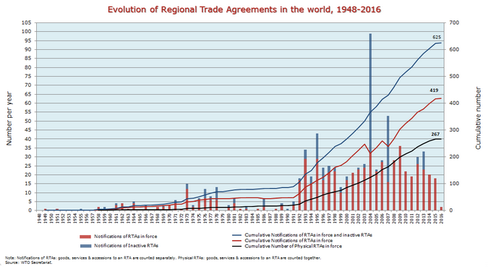
WTO
Notes:
https://www.wto.org/english/tratop_e/region_e/regfac_e.htm

Slide 9
US FTAs
1985 Israel | 2004 CAFTA-DR
1989 Canada | 2005 Bahrain
1992 NAFTA | 2006 Oman
2000 Jordan | 2006 Colombia*
2003 Singapore | 2006 Peru
2003 Chile | 2007 Panama*
2004 Australia | 2007 Korea*
2004 Morocco
Years are dates FTAs on goods were signed.
*Entry into force 2012.

Slide 10
US FTAs: In Process
TPP with 11 countries
TTIP with EU

Slide 21
“Mega-FTAs”
Mega-FTAs of the Past
European Union (grew from 6 to 28 countries) – Customs Union
MERCOSUR (Grew from 4 to 6 South American countries)
ASEAN FTA (10 countries)
4 in Africa
EAC (5 countries)
ECOWAS (15 countries)
COMESA (19 countries)
SADC (15 countries)

Slide 22
Today: New “Mega-FTAs”
TPP: Trans-Pacific Partnership
Negotiations
Launched 2008
Completed Oct 5, 2015
Includes 12 countries (US, Japan, …)
Yet to be ratified
Intended to be open to additional countries
Indonesia
S. Korea
Philippines

Slide 23
Today: New “Mega-FTAs”
RCEP: Regional Comprehensive Economic Partnership
Negotiations launched 2012
10-member ASEAN, plus 6 countries with which ASEAN has FTAs:
Australia
China
India
Japan
S. Korea
New Zealand

Slide 24
Today: New “Mega-FTAs”
TTIP: Trans-Atlantic Trade and Investment Partnership
Negotiations launched 2013
Includes
US
28-member EU

Slide 25
Today: New “Mega-FTAs”
Tripartite Free Trade Area
Launched June 10, 2015
Will combine 3 of the 4 mega-FTAs in Africa:
EAC (5 countries)
COMESA (19 countries)
SADC (15 countries)
Total 27 countries (due to overlap)

Slide 26
More on TPP

Slide 27
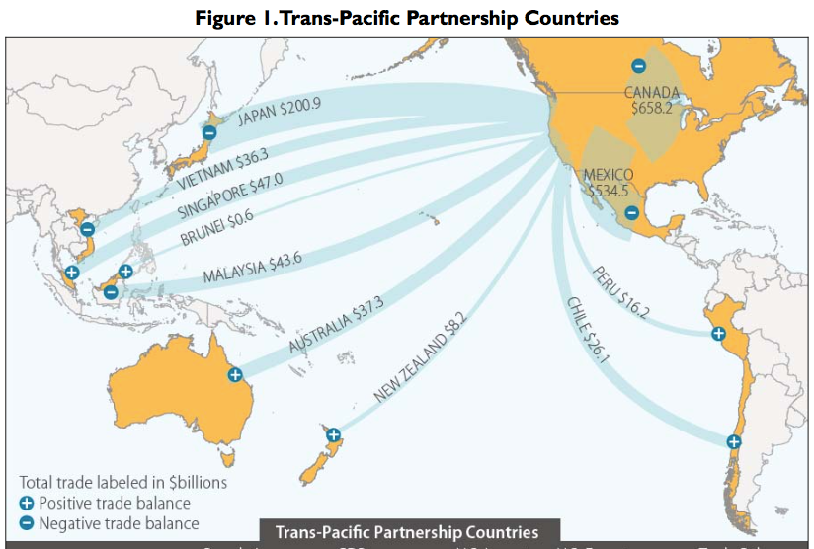
X?

Slide 28
What Is the TPP?
Main Features of TPP (only a few of 30 chapters):
Trade in goods: Reduce/remove tariffs & NTBs
Trade in services: Reduce/remove barriers
Digital trade: Facilitate data flows and E-commerce
Investment: Investor/State Dispute Resolution
Intellectual Property: Expanded patents, etc.
Labor: Enforcement of standards
Environment: Enforcement of standards
State-Owned Firms: Competitive neutrality

Slide 29
Oddities of the TPP
Tariffs
Cars and trucks: US tariffs removed
Cars: 2.5%, removal phased in over 25 years.
Trucks: 25%, removal phased in over 30 Years.
Schedules and rates differ by exporting country

Slide 30
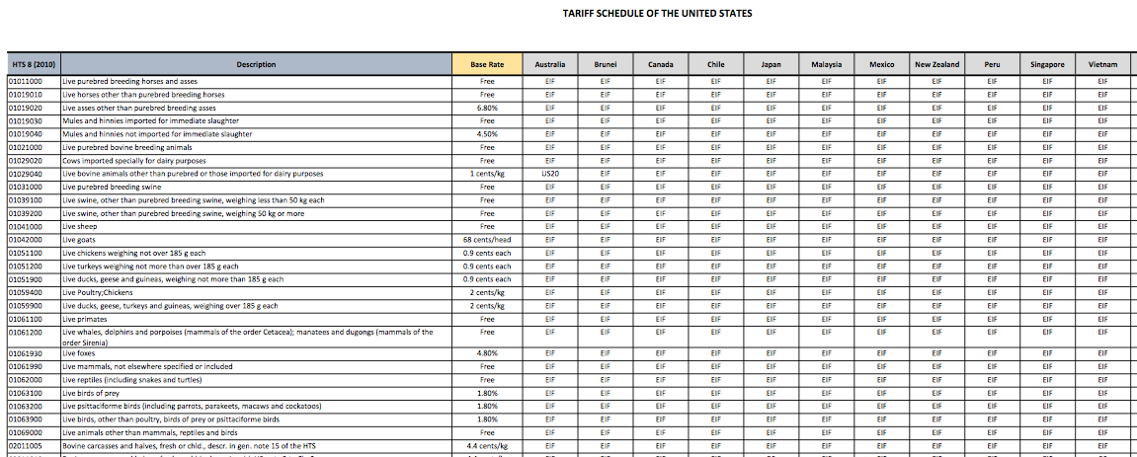

Slide 31
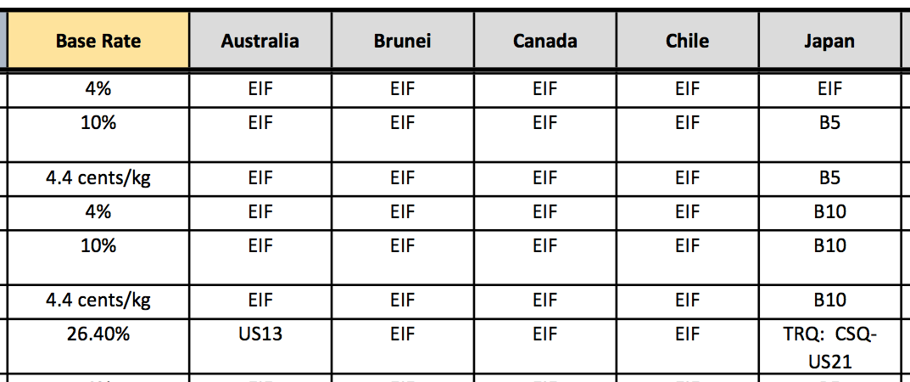
EIF: Entry In Force (duty-free from start)
B5: Eliminated in 5 annual stages, duty-free in year 5
B10: Eliminated in 10 annual stages, duty-free in year 10
Bovine Meat Cuts (i.e., Beef)
US21: No higher that Peru FTA
US13: Base rate until 2022; duty-free in 2022

Slide 32
Oddities of the TPP
ISDS: Investor/State Dispute Resolution
Controversial
Does not apply to tobacco industry

Slide 33
Oddities of the TPP
Biologic Drugs
(advanced medicines made from living organisms)
The issue: Time period of permitted data exclusivity
US wanted 12 years of protection, as contained in the Obama Care.
Australia and others wanted much shorter protection, 5 or 6 years.
Compromise: US keeps 12-years; others will not. 5 years protection will be an increase for some countries.

Slide 34
Oddities of the TPP
Japanese Agriculture:
Japan will lower its tariff on beef from over 38.5% to 9% over 16 years
Pork tariff will fall from 4.3% to 2.2%, but will also lower minimum import price from ¥482/kg to ¥125, and later to ¥50.
Rice (no cut in tariff): New duty-free quota of 50,000 tons, rising to 75,000 tons in year 13

Slide 35
Oddities of the TPP
Exchange Rates
US wanted TPP to address currency undervaluation (which makes exports cheaper)
Resolution: Side Agreement on Exchange Rates:
Commitment to avoid manipulation
Transparency and Reporting
Group to meet at least annually to discuss macroeconomic and exchange rate issues
No enforcement mechanism

Slide 36
Pros and Cons of all FTAs
Preferential tariff cuts
Pro: trade creation
Similar to the classic “gains from trade”
Cons:
Trade diversion
Rules of origin (ROOs)
Exemption of sensitive sectors
Sensitive = Most likely to be trade-creating if included

Slide 37
Pros and Cons of all FTAs
Other aspects of actual FTAs
Pros:
Extension to trade in services
Harmonization of regulations
Cons (?):
Extension of IP protection
Trade enforcement of labor standards
Trade enforcement of environmental standards
Investor-State Dispute Settlement

Slide 38
Additional Pros and Cons of Mega-FTAs
Preferential tariff cuts
Pros:
Larger potential for trade creation
If ROOs are cumulative, less distorting
Potential for adding members
Replace multiple rules with a single set
Cons:
Though there are fewer outsiders, each is harmed more by trade diversion
In fact (in TPP) there is more complexity

Slide 39
Additional Pros and Cons of Mega-FTAs
Other aspects of actual Mega-FTAs
Pros:
May contribute to broader and more uniform standards
Cons:
Their use as weapons of geopolitics

Slide 40
Implications of Mega-FTAs for the WTO
Might have created pressure to complete Doha Round.
Possible, just as NAFTA motivated Uruguay Round
Didn’t happen; Round is dead.

Slide 41
Implications of Mega-FTAs for the WTO
By lowering trade barriers regionally, Mega-FTAs will
Hasten the decline of some uncompetitive industries,
Thus gradually reduce political forces for protection
This may reduce the need to use WTO-sanctioned administrative protection (anti-dumping, etc.)

Slide 42
Implications of Mega-FTAs for the WTO
Trade disputes will have alternative fora in which to be settled: Choice between WTO panels and FTA panels
This may lessen the role of the WTO Dispute Settlement Mechanism
But it will remain relevant

Slide 43
Implications of Mega-FTAs for the WTO
WTO will continue to be important for plurilateral negotiations on issues that transcend the Mega-FTAs
Some issues that lend themselves neither to plurilateral agreements not to Mega-FTAs will remain unresolved
Most important: Subsidies

Slide 44
Implications of Mega-FTAs for the World Trading System
Ideally, they will move the world in the direction of global free trade
But because of their size, each may fall short of that ideal even internally
Rules of origin undermine their benefits
Exemption of “sensitive sectors” will systematically reduce beneficial trade creation

